Slide 1
SVs and mutations in chromatin modifier genes
2021-01-22
Luan Nguyen

Slide 2
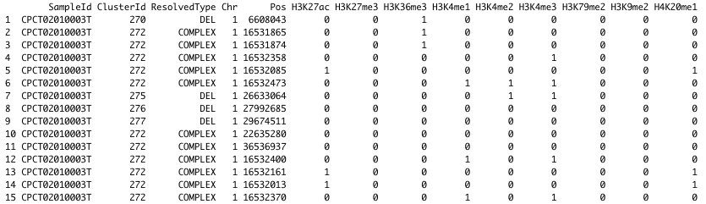
Input data
SV type associated with each breakpoint (determined by LINX)
Breakpoint located at histone mark?
(annotation based on processed public ENCODE ChIP-seq tracks used in Boxtel et al Nature 2016)
4784 HMF tumor samples
1 row =
1 breakpoint

Slide 3
Selecting samples with mutated and unmutated genes

Slide 4
Gene deficiencies
Biallelic loss
Deep deletion (full gene copy number loss)
LOH + somatic mutation (known pathogenic, or missense/nonsense/frameshift)
LOH + germline known ClinVar pathogenic mutation
2 pathogenic somatic mutations
Wild type
No LOH
Remaining allele has VUS or lower in impact

Slide 5
Gene amplifications
Amplification
Focal or arm copy number gain (≥3x genome copy number) at gene region
Wild type
Copy number gain ≤1.2x genome copy number

Slide 6
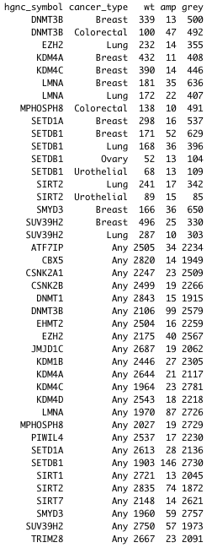
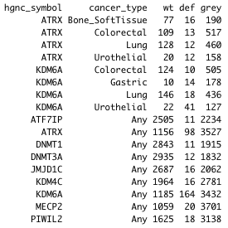
Compare samples with WT vs mutated genes
Require ≥10 mutated samples and ≥10 WT samples
Deficiences
Amplifications

Slide 7
Results: gene deficiencies

Slide 8
Significance labels
p-value | Label
<0.01 | *
<0.001 | **
<0.0001 | ***
Cliff’s delta | Label | Effect size
≥0.05 | + | Very low
≥0.1 | ++ | Low
≥0.2 | +++ | Medium
≥0.3 | ++++ | High

Slide 9
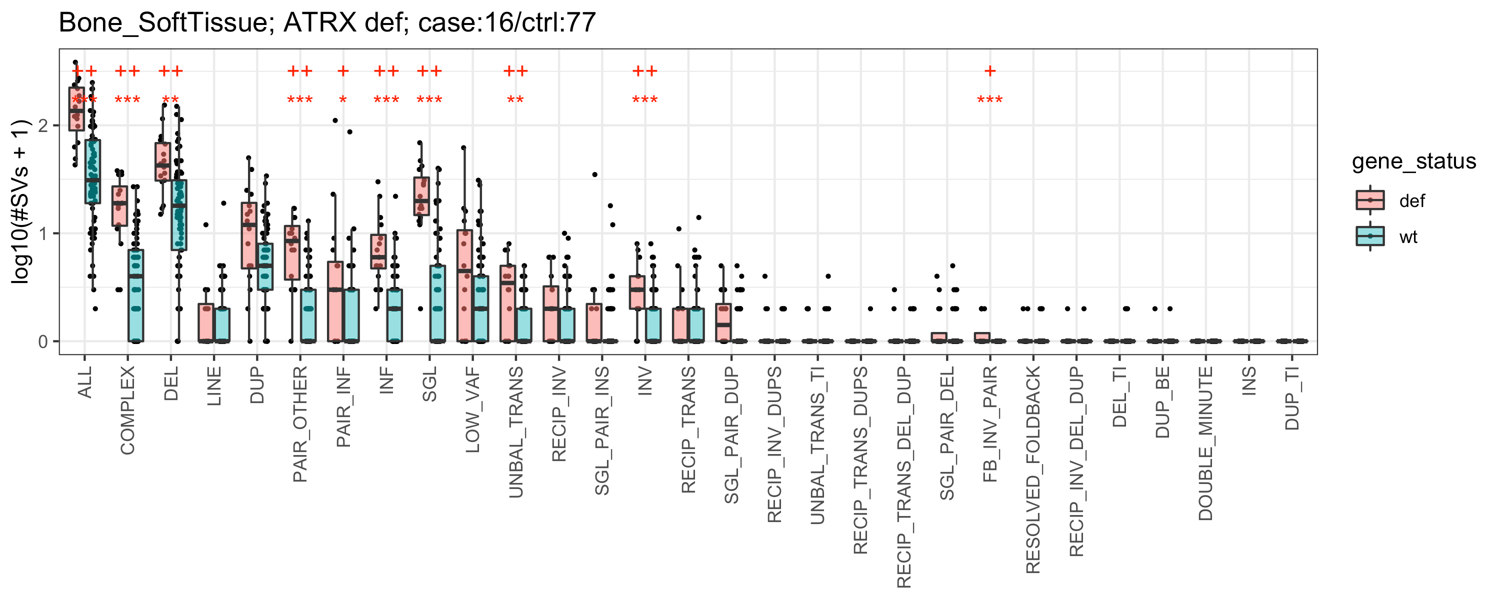
ATRX: deposits H3.3 at telomeres and genomic repeats

Slide 10
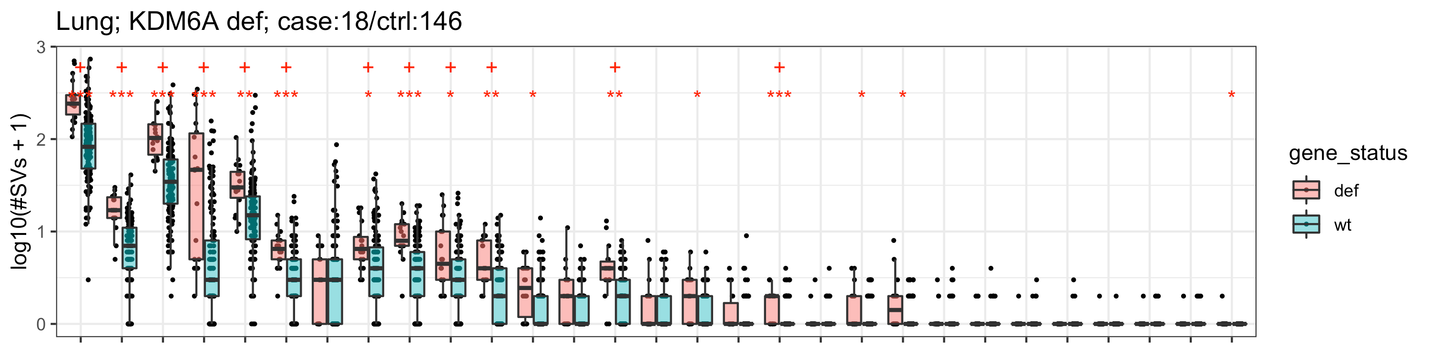
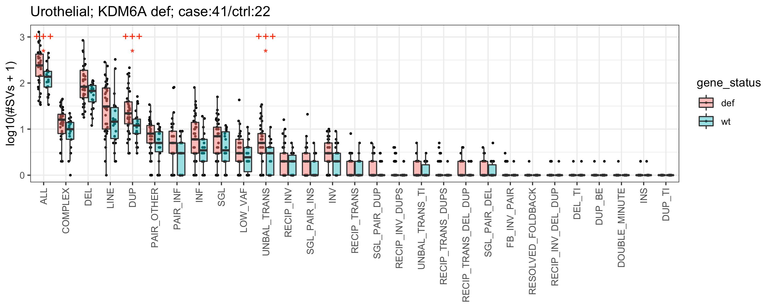
KDM6A: H3K27 demethylase

Slide 11
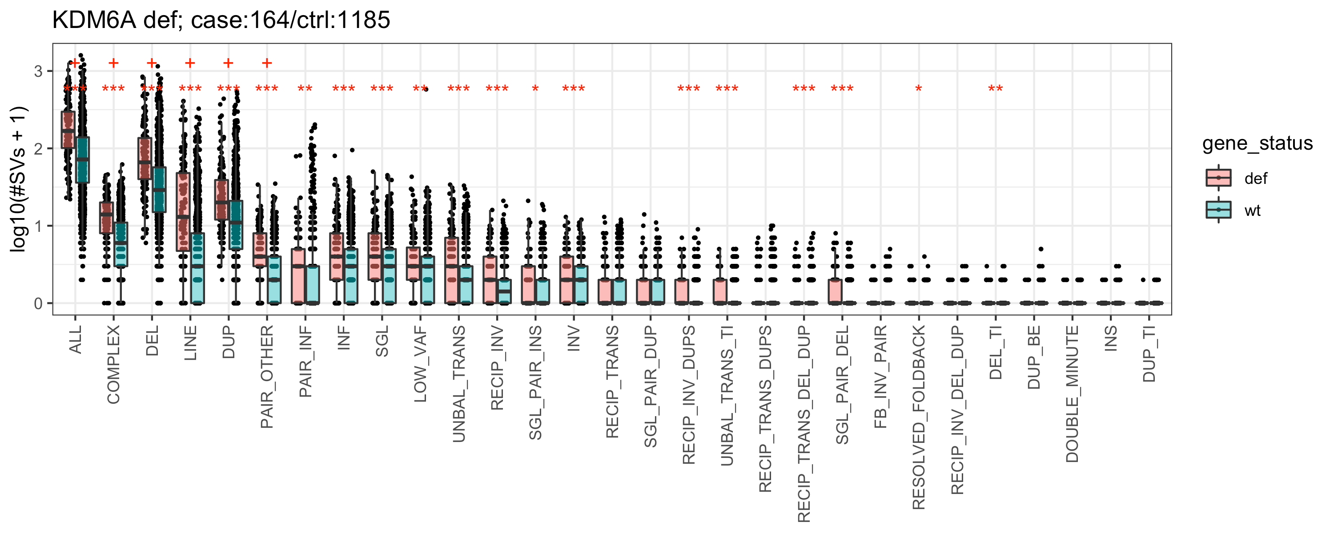
KDM6A (any cancer type)

Slide 12
Results: gene amplifications

Slide 13
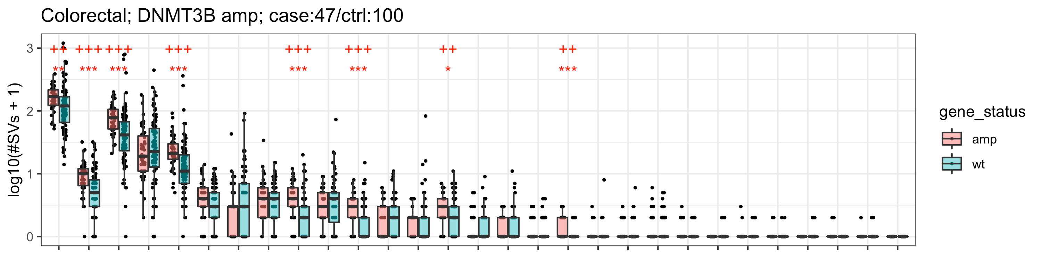
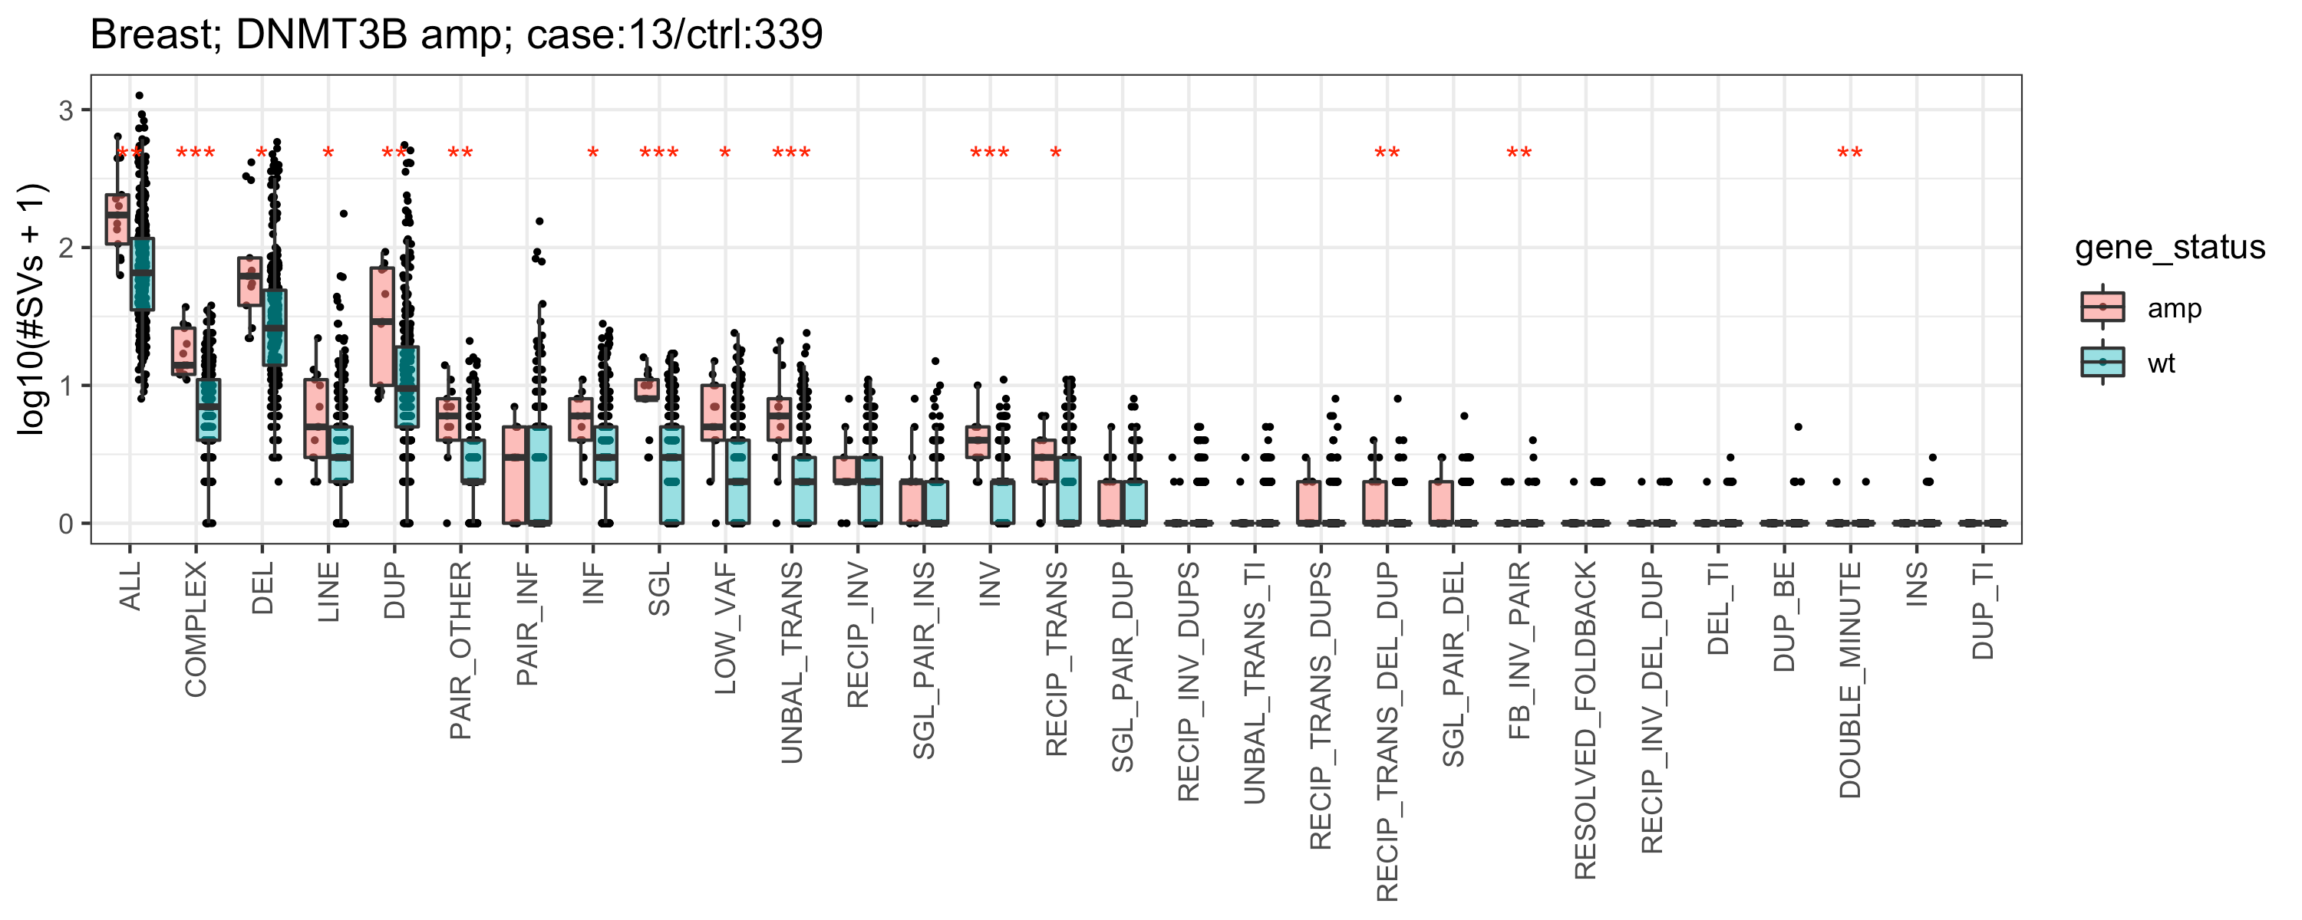
DNMT3B: genome-wide de novo methylation

Slide 14
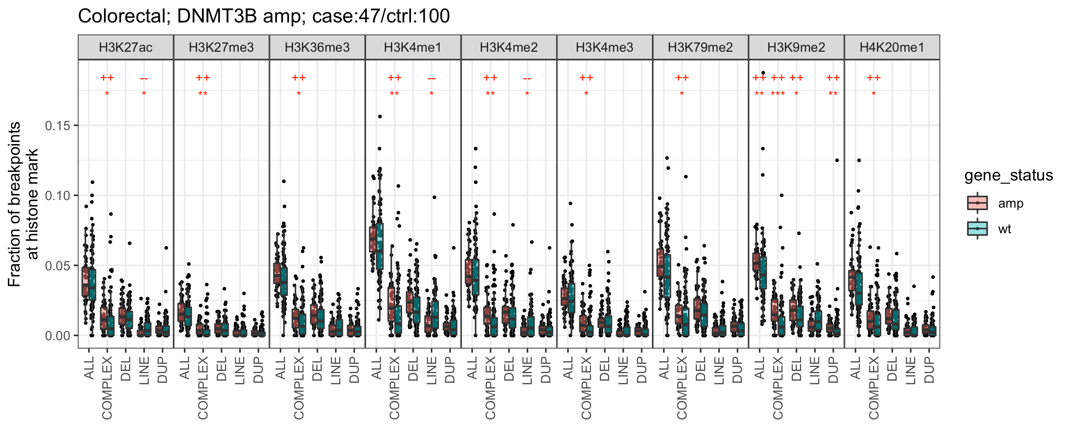
DNMT3B (breakpoints at histone marks)

Slide 15
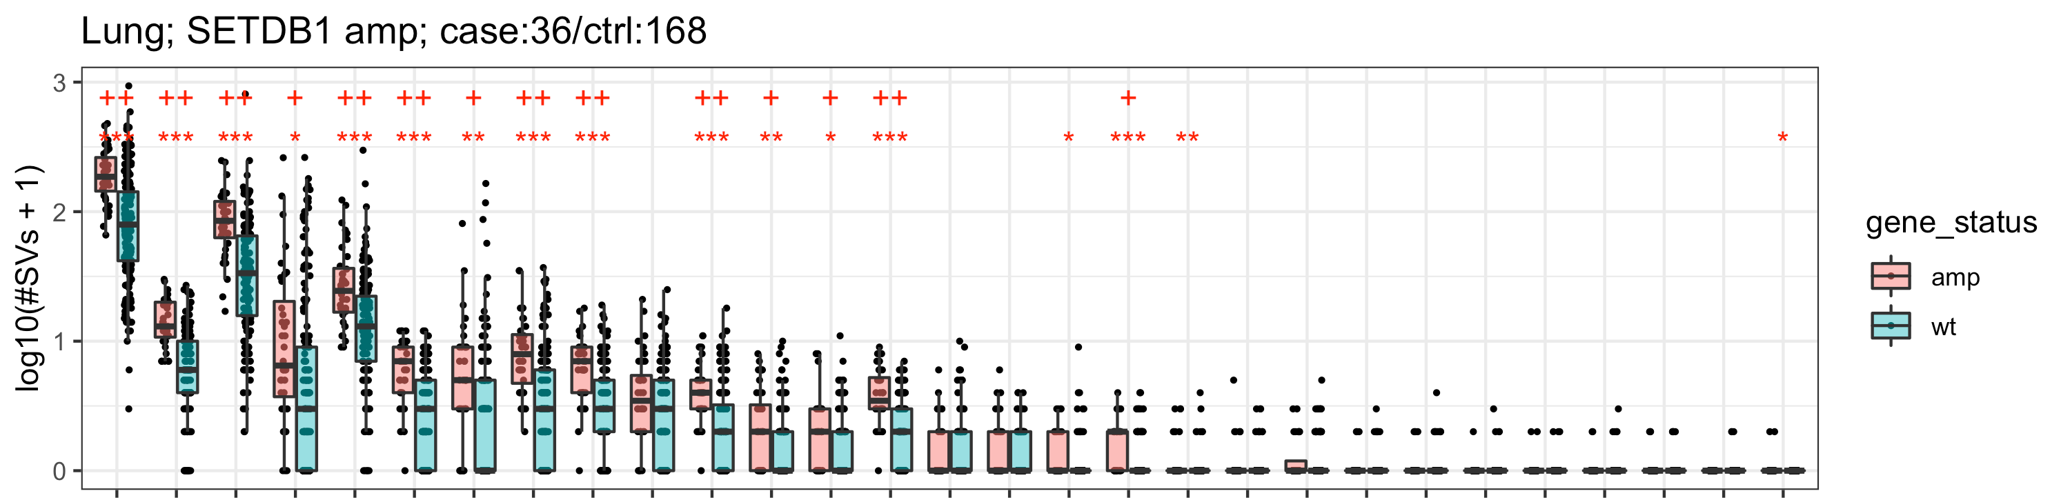
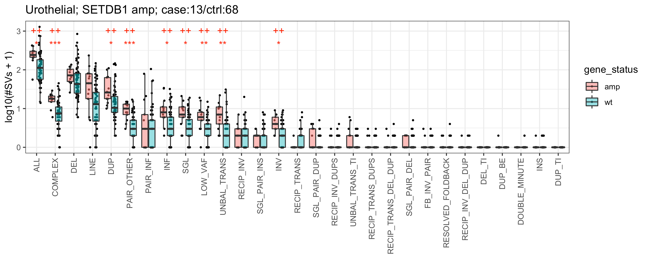
SETDB1: H3K9 trimethylator

Slide 16
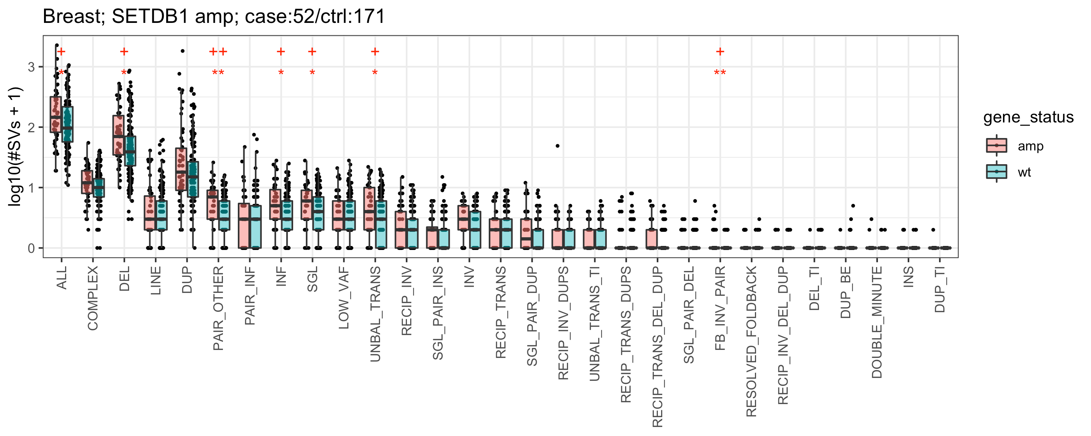
SETDB1: H3K9 trimethylator

Slide 17
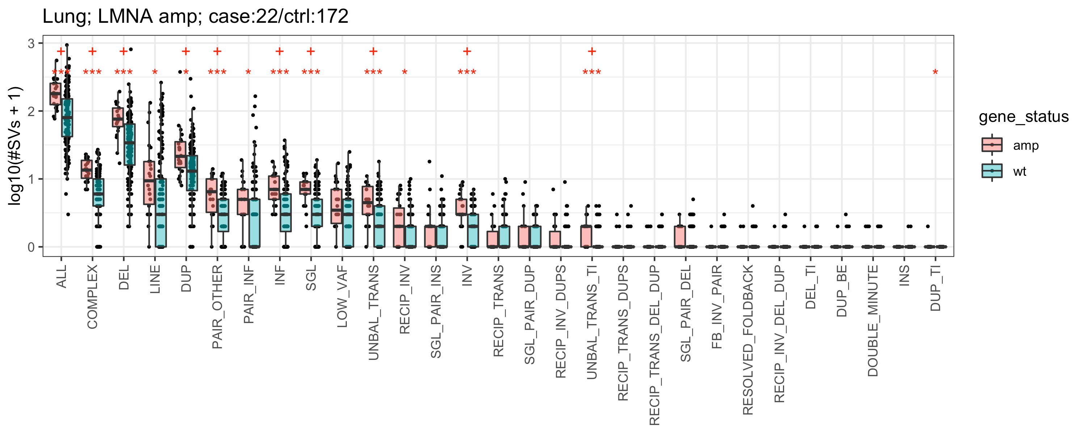
LMNA: part of nuclear envelope and may interact with chromatin
LMNA and SETDB1 both on Chr1q
SETDB1 amp more likely the cause of increased #SVs

Slide 18
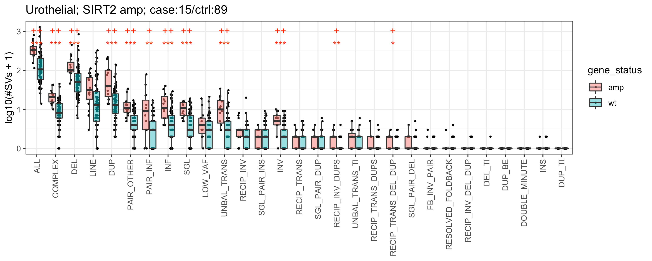
SIRT2: lysine deacetylase

Slide 19
Summary
Increase in no. of SVs is
cancer type specific
not specific to certain SV types
not enriched at certain histone marks
Likely real correlations:
ATRX def in Bone/Soft tissue
KDM6A def in Lung and Urothelial (in any cancer type?, very low effect size)
DNMT3B amp in Colorectal
SETDB1 amp in Lung and Urothelial
SIRT2 in Urothelial
Weak correlations:
LMNA amp in Lung (very low effect size, side-effect of SETDB1 amp)
SETDB1 amp in Breast

